Slide 1
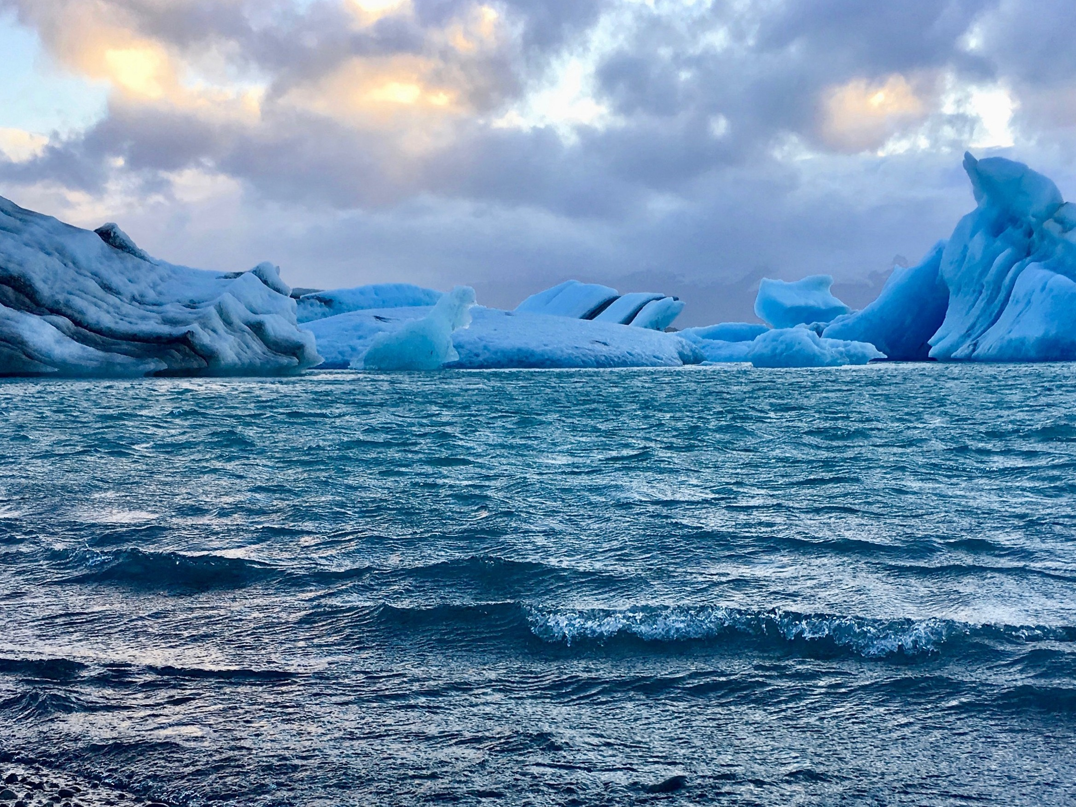

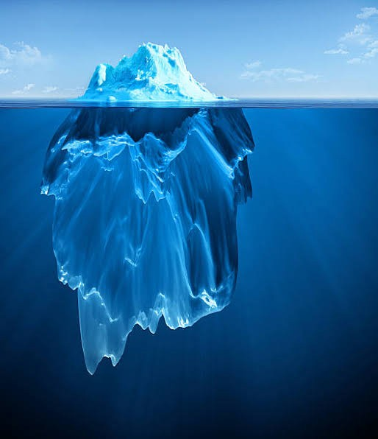
IceBerg Detection in Satellite Images using IBM Watson Studio
TEAM : IT-005
K.Siddharth
K.Nitin Kumar
M.Santhoshi
Neekshith Reddy
Chandrashekhar Reddy

Slide 2

Introduction
Icebergs present serious hazards for ship navigation and offshore installations. Iceberg roots a dangerous risk for transportation, marine oil and gas production plants.
Data on Iceberg and Island is significant for atmosphere science and for different marine activities in the sea.
The main objective of our study is to estimate the possibility of using different satellite images for iceberg detection among open water, fast ice and drifting ice.

Slide 3
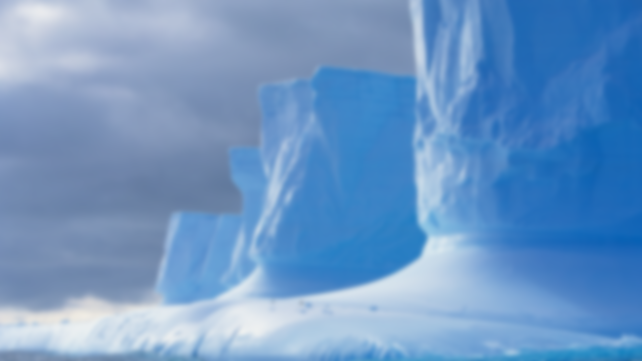
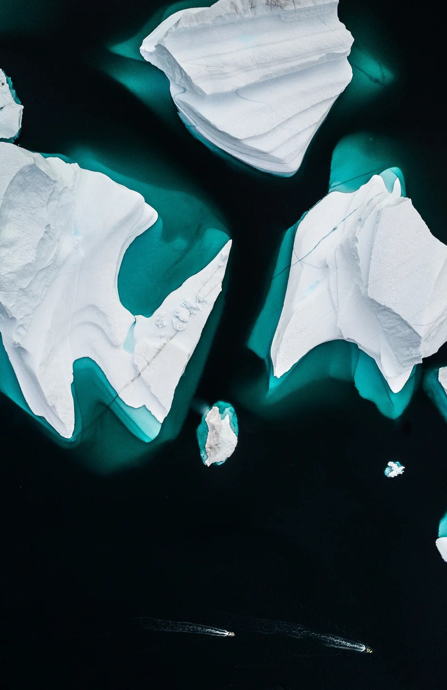
Three Situations
Icebergs in open water :
Icebergs will show bright spots against a dark background in optical images, higher wind reduces the contrast between open water and icebergs.
Icebergs in drifting ice :
Icebergs will create tracks in the drifting ice if there are larger floes of consolidated ice. Difficult to distinguish icebergs from a background in optical images if only backscatter information is available.
Icebergs in fast ice near calving areas :
Optical data shows shadows against the background, stationary ice means possible to identify icebergs over longer time periods.

Slide 4
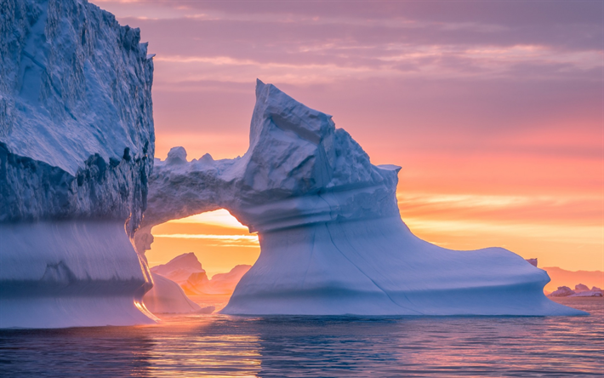

Automatic detection of icebergs in satellite images is regarded as a useful tool to provide information necessary for safety in Arctic shipping or operations over large ocean areas in order to prevent accidents.
The ice below the water is dangerous to ships. The sharp, hidden ice can easily tear a hole in the bottom of a ship. A particularly treacherous part of the North Atlantic has come to be known as Iceberg Alley because of the high number of icebergs that find their way there.

Slide 5
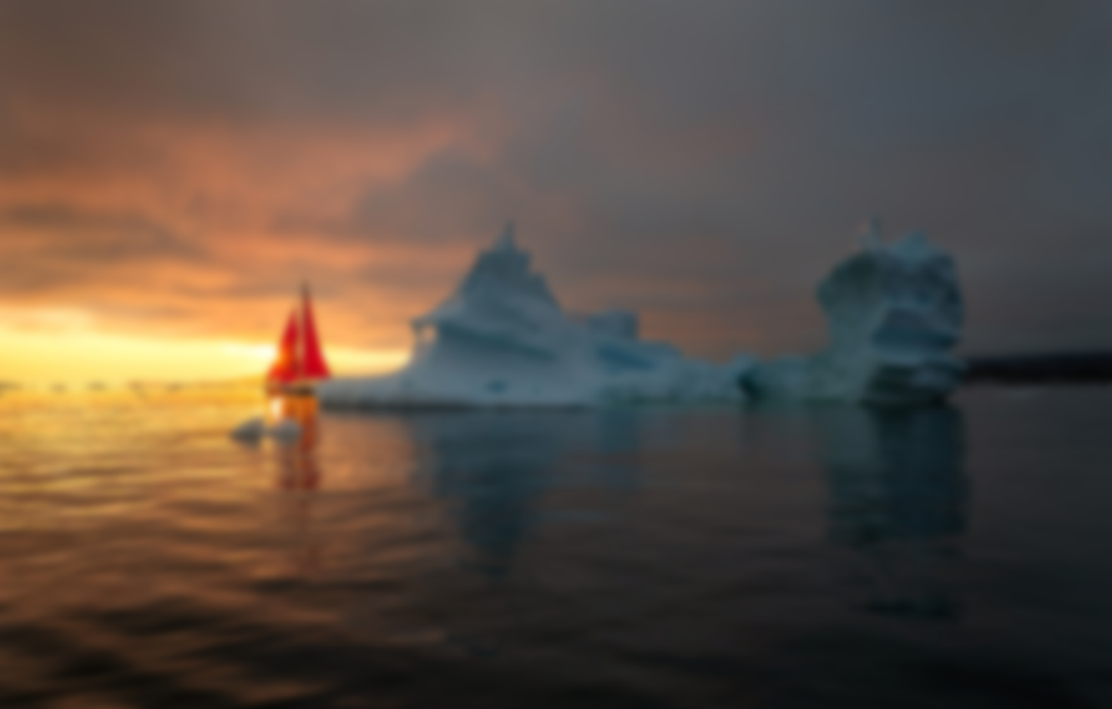


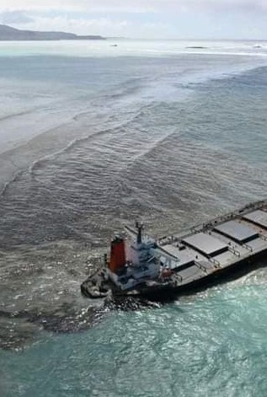
When oil accidentally spills into the ocean, it can cause big problems. Oil spills can harm sea creatures, ruin a day at the beach, and make seafood unsafe to eat.
Oil spills penetrate into the structure of the plumage of birds and the fur of mammals, reducing its insulating ability, and making them more vulnerable to temperature fluctuations and much less buoyant in the water.
Oil spills can have disastrous consequences for society, economically, environmentally, and socially.

Slide 6

Environment and tools used :
Scikit-learn.
Numpy.
Keras.
Pandas.
Matplotlib.
Model building through Jupyter notebook.
Using HTML,CSS and JavaScript for webpage.
Using Flask for integrating model and webpage in SPYDER environment.

Slide 7

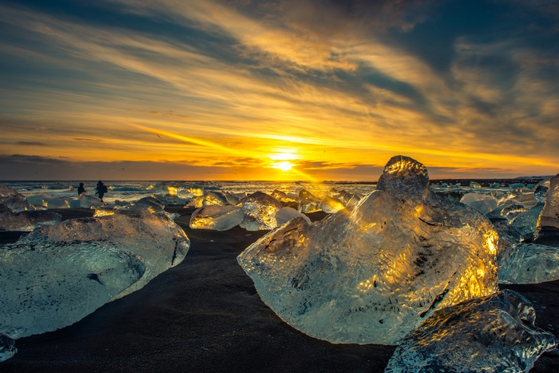
Thank
You - IT005

Slide 8

Thank
You – IT005

